Slide 1
Implicit Bias

Slide 2
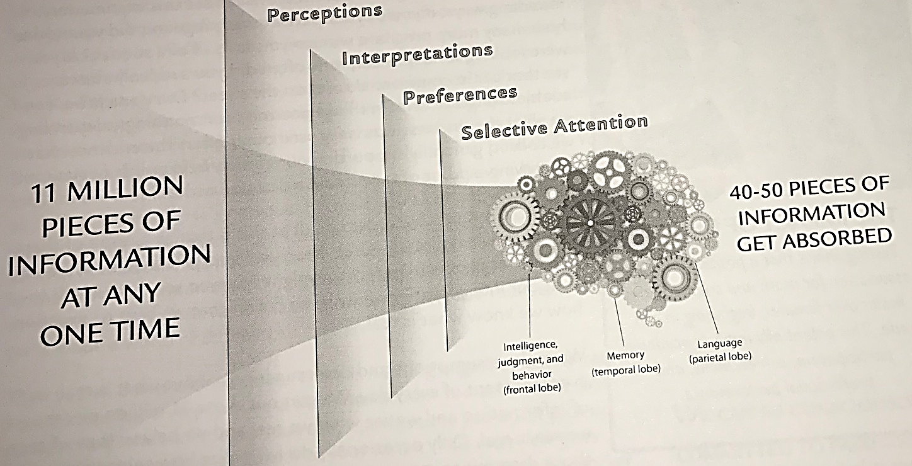
Unconscious Bias Workbook, Cook Ross Incorporated

Slide 3
Our Mind’s Filters
Learned from
Families
Friends/peers
Life Experiences
Media
Result from direct or indirect experiences
Have positive and negative associations

Slide 4
Implicit Biases
Culturally shared
Men and women have them about gender
Whites and People of Color have them about race/ethnicity
Allow efficient, if sometimes inaccurate, processing of information
People are not aware of them
Often conflict with consciously held or explicit attitudes
Change based on experience/exposure

Slide 5
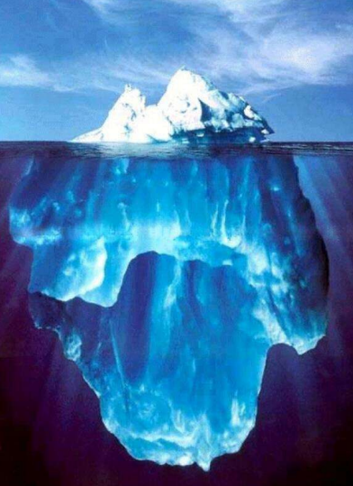
Conscious beliefs
Unconscious beliefs
(Implicit biases)

Slide 6
Bias isn’t Bad
Bias is a normal part of human behavior.
Making snap decisions helps us survive.
Human brains need the ability to sort things quickly to make decisions.
Previous experiences help keep us safe in similar situations.

Slide 7
IX

Slide 8
Why am I unaware?
We view ourselves as fair and impartial.
We believe advancement is merit-based.
We admire the competence of some.
We see an atypical event and forget that it is not the norm.

Slide 9
Debiasing
Education
Awareness
Being mindful
Exposure
Contact
Positive examples
Perspective taking
Approach
Checklists
Intentionality
Accountability

Slide 10
Retraining
Nurture
Nurture constructive uncertainty
Learn
Learn to use the flashlight approach to identify bias
Do not suppress
Do not suppress beliefs; understand and redirect them
Explore
Explore awkwardness or discomfort
Create
Create opportunities for positive exposure

Slide 11
What can I do?
Attention
Pay attention to the messages that you take in.
Slow down
Slow down. Try not to make quick or stressed decisions.
Widen
Work to widen your network group and experiences you have.
Consider
Consider opposite opinions.
Judge potential and performance equally.
Be
Be humble. Be self-aware.
Equal

Slide 12
Resources
www.lookdifferent.org
Project Implicit - https://implicit.harvard.edu/implicit/
Kirwan Institute - https://womensplace.osu.edu/assets/files/Educational_Resources-Bias_in_Everday_Situations-2017.pdf
Playfairgame.org

Slide 13
Questions?

