Slide 1
REVIEWING AND EXTRACTING FACULTY ACTIVITY DATA
Texas A&M AgriLife Interfolio User Guide
For Staff Members
For questions about your experience in Faculty Activity Reporting, you can email the AgriLife help team at: agrilifef180help@ag.tamu.edu

Slide 2
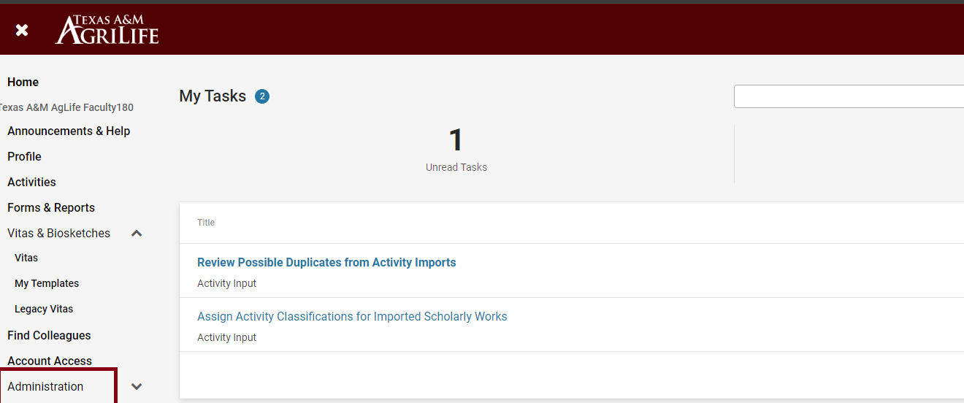
Review and Approve Faculty Input
Navigate to the “Administration” tab on the left navigation menu.

Slide 3
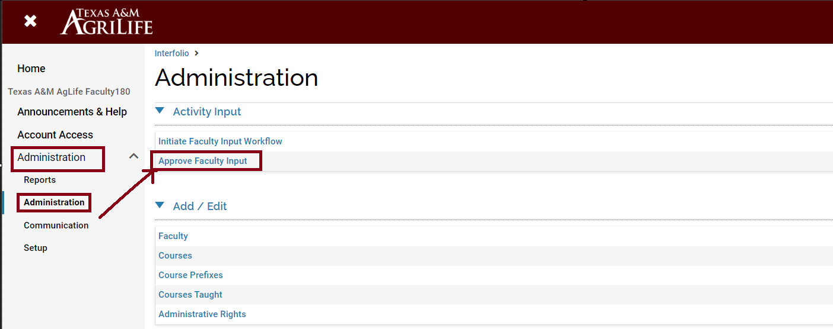
Review and Approve Faculty Input
Navigate to the “Administration” sub-menu and select “Approve Faculty Input” under the “Activity Input” header.

Slide 4
Review and Approve Faculty Input
Click on the eye icon under the “Actions” column to reveal Activity Input submissions for users in your unit.

Slide 5
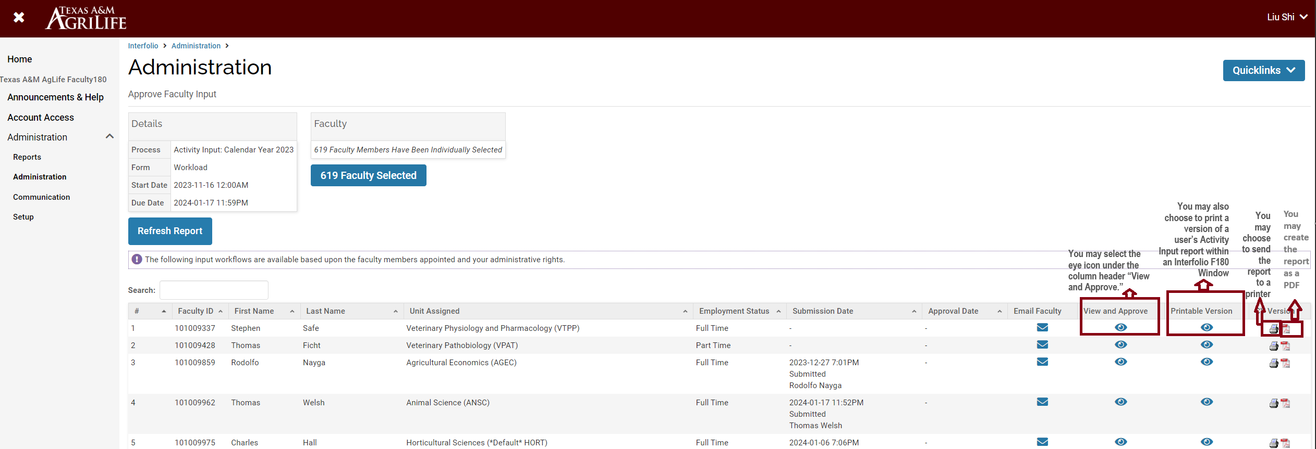
Review and Approve Faculty Input
Continue to drill down into your unit you see individual faculty records.

Slide 6
View and Export Activity Input Forms for Users in your Unit
Navigate to the “Administration” tab on the left navigation menu.

Slide 7
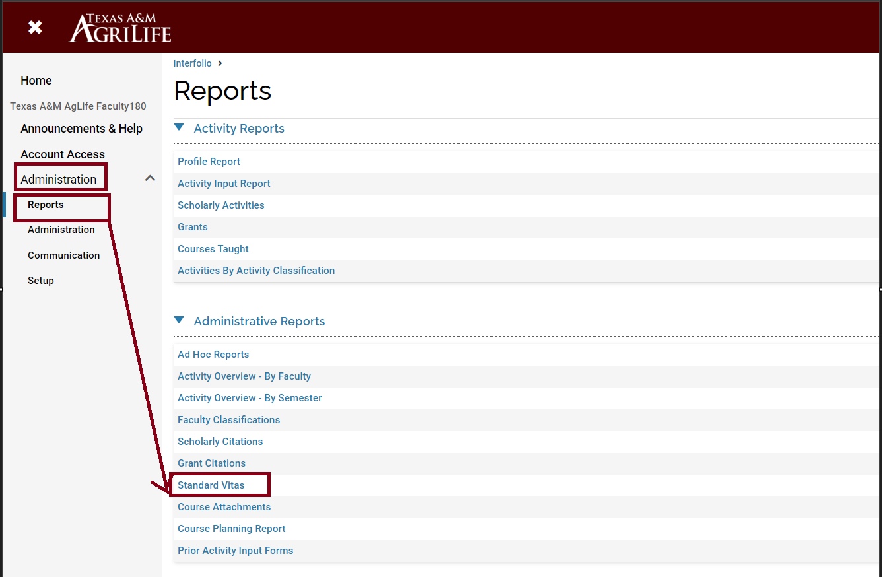
View and Export Activity Input Forms for Users in your Unit
Navigate to the “Reports” sub-menu and select “Standard Vitas” under the “Administrative Reports” header.

Slide 8
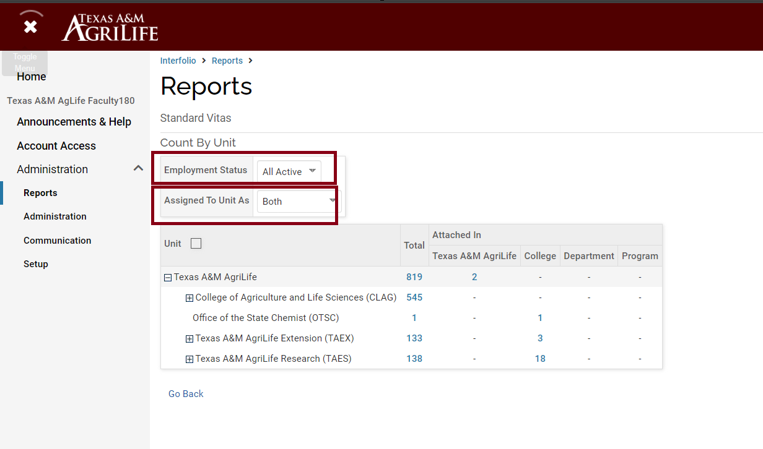
View and Export Activity Input Forms for Users in your Unit
Adjust the ‘Employment Status’ and ‘Assigned To Unit As’ filters as appropriate. We recommend “All Active” and “Both”, respectively, to be as inclusive of employed faculty as possible.

Slide 9
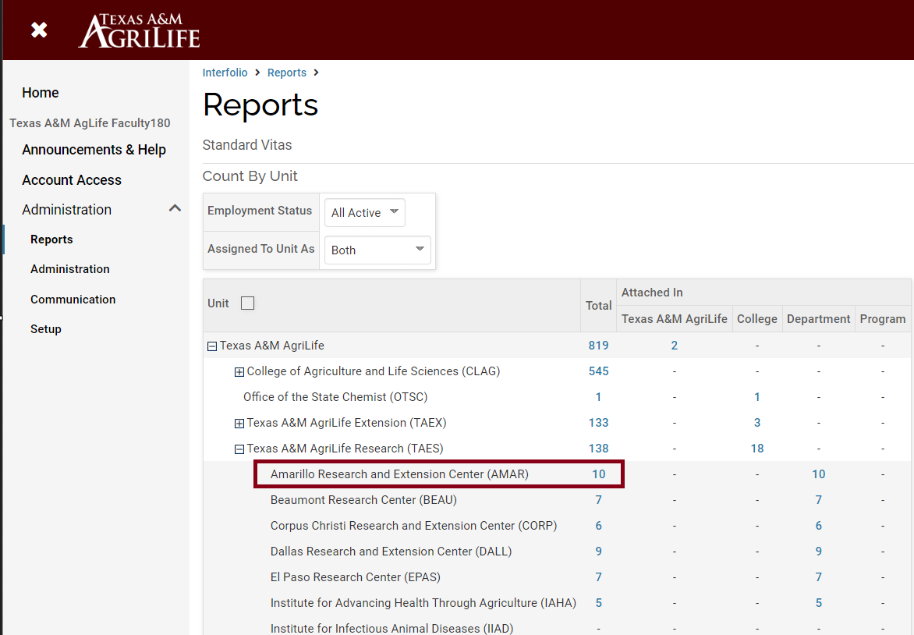
View and Export Activity Input Forms for Users in your Unit
Click on the numeric headcount for the unit for which you’d like to see data. As an example, we could click on the 10 individuals tied to the Amarillo Research and Extension Center (AMAR) to expand data for those 10 faculty members.

Slide 10
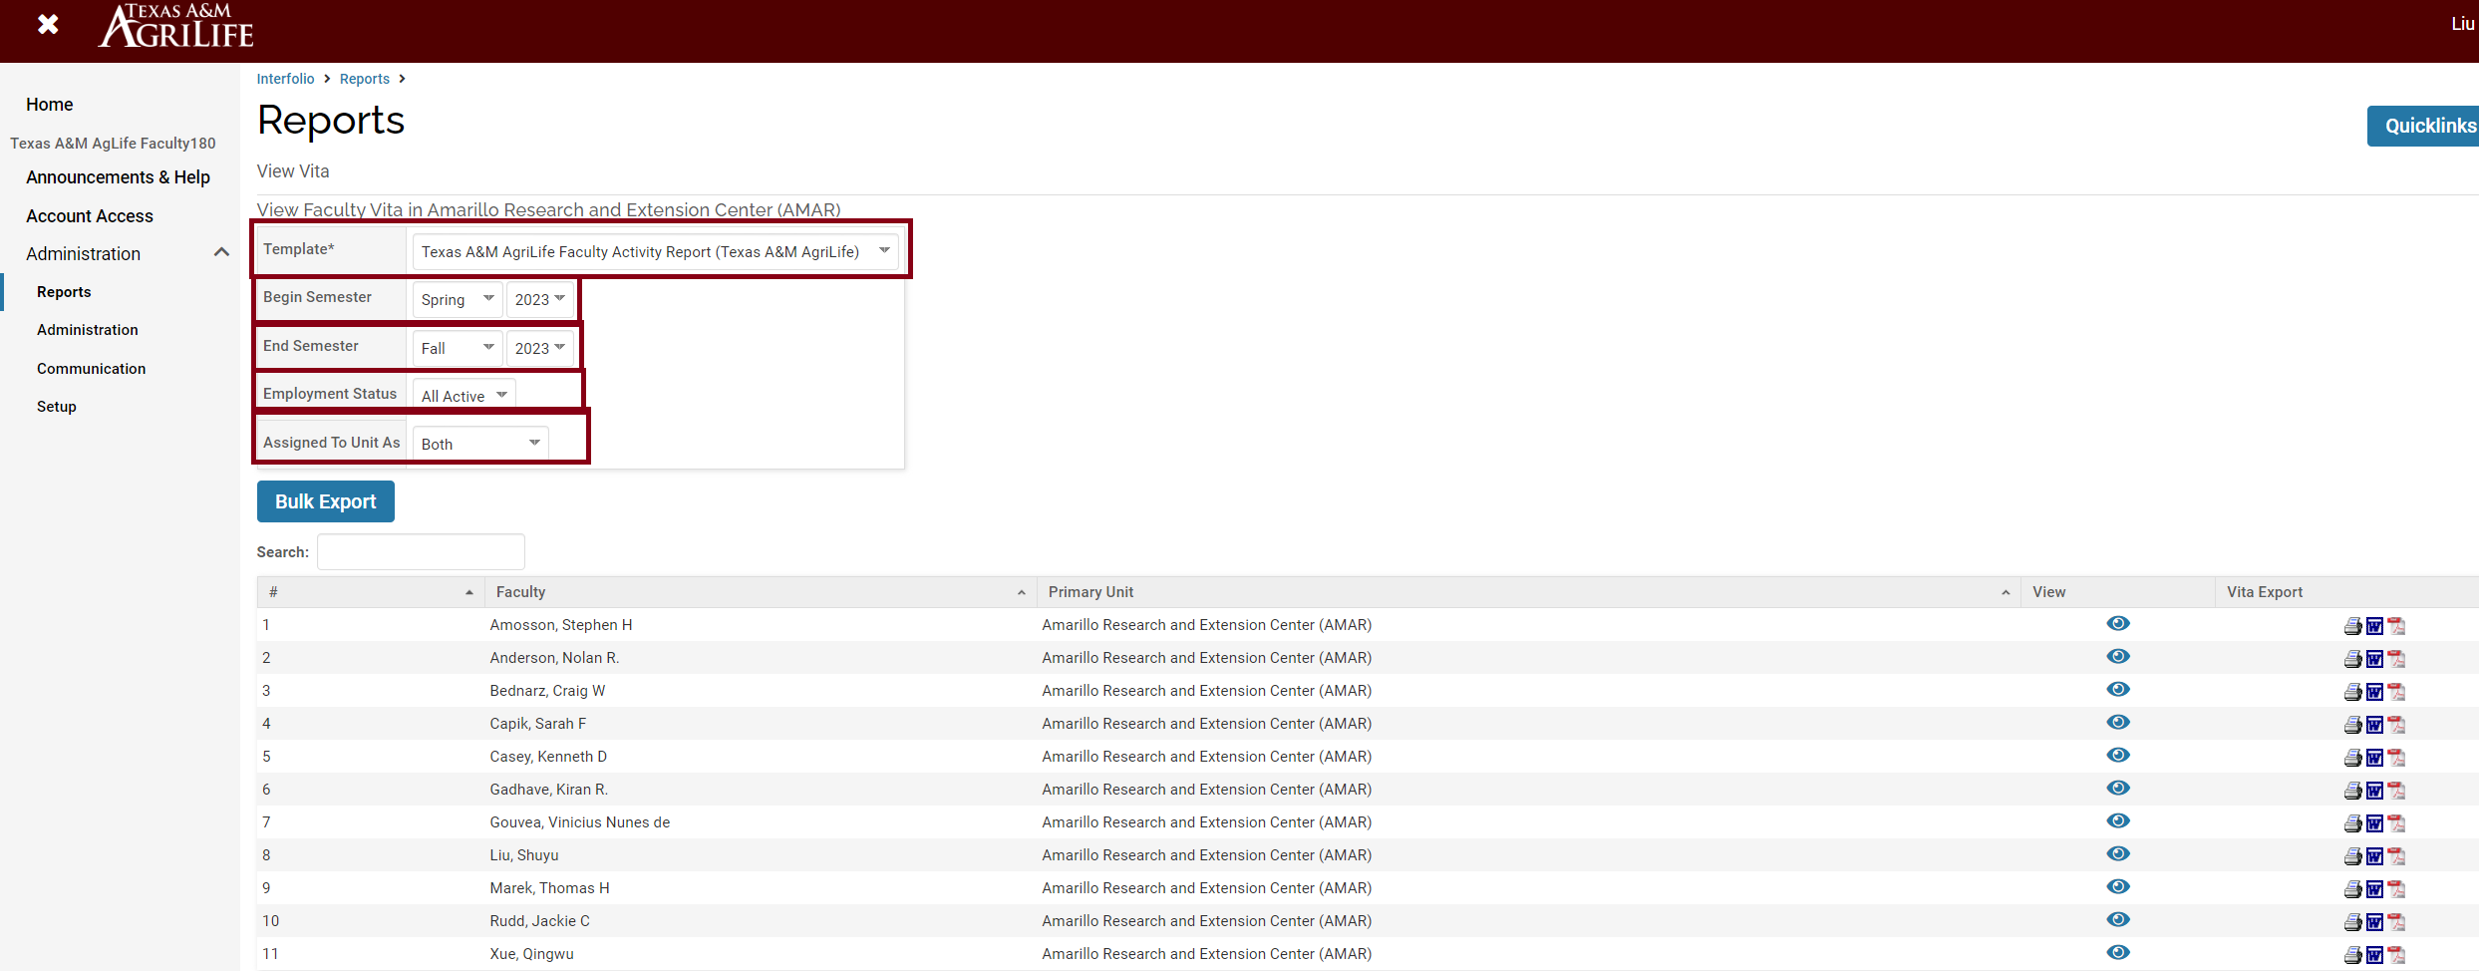
View and Export Activity Input Forms for Users in your Unit
To access and view or export records in the correct format, choose the ‘Template’ format “Texas A&M AgriLife Faculty Activity Report”, and modify the date range for the appropriate year (e.g., Spring 2023 through Fall 2023 for the calendar year 2023), and then either choose to view individual records or the “Bulk Export” option.

Slide 11
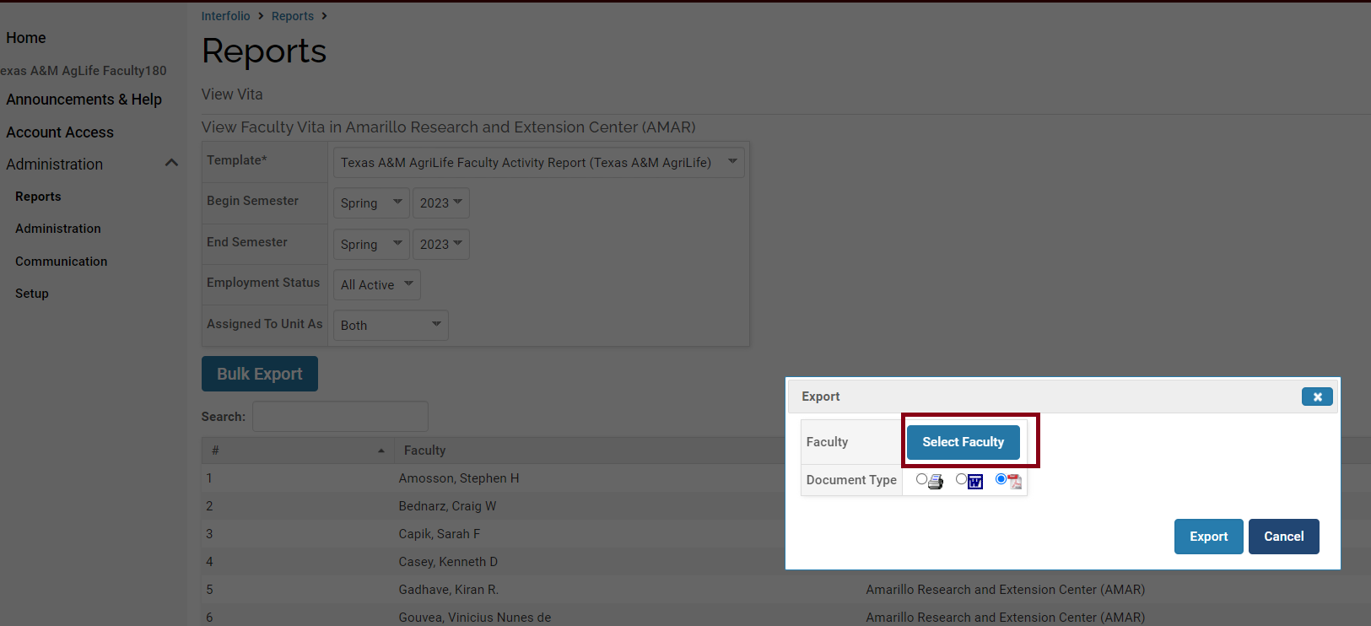
View and Export Activity Input Forms for Users in your Unit
To export Activity Input reports in bulk, select the document type (i.e., the format you’d like Interfolio F180 to use for your file exports) and choose “Select Faculty.”.

Slide 12
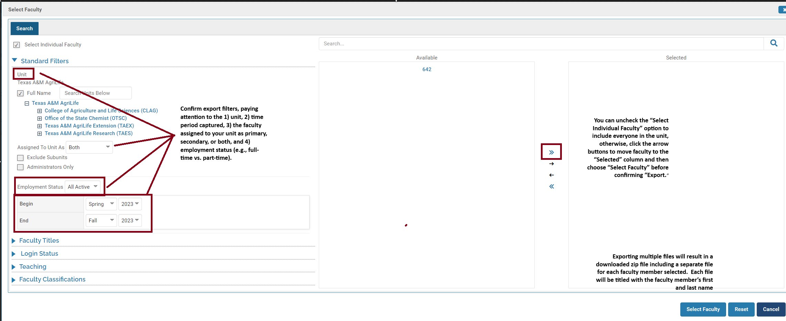
View and Export Activity Input Forms for Users in your Unit
Confirm export filters and export.

Slide 13
View and Export Aggregated Activity Data for Users in your Unit
If you want to view some aggregated data for all the faculty members in you unit, you can create an aggregate report.
Navigate to the “Administration” tab on the left navigation menu.

Slide 14
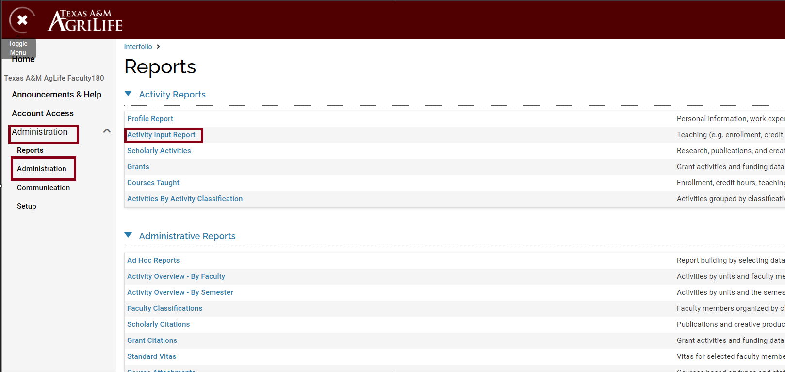
View and Export Aggregated Activity Data for Users in your Unit
Navigate to the “Reports” sub-menu and select “Activity Input Report” under the “Activity Reports” header.

Slide 15
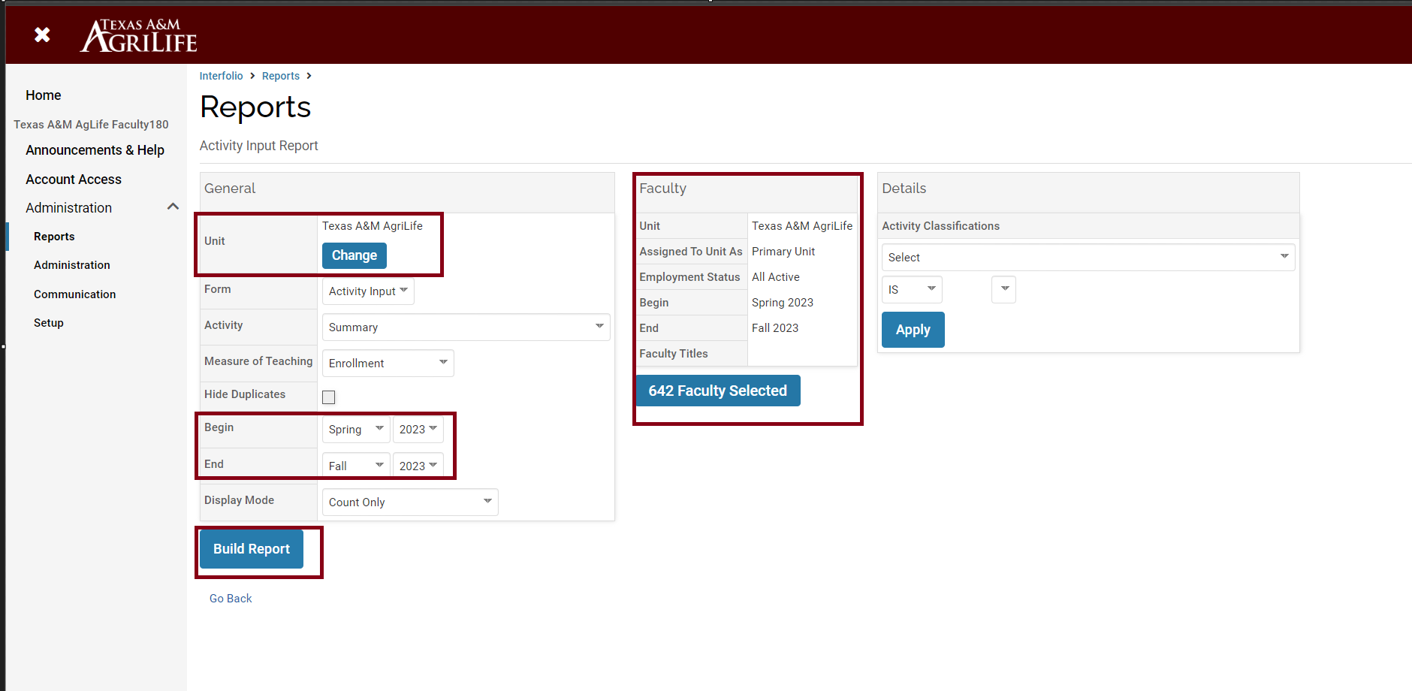
View and Export Aggregated Activity Data for Users in your Unit
Modify all filters relevant to your report request, ensuring that the unit, date range and faculty included are correct, and then choose “Build Report”.

Slide 16
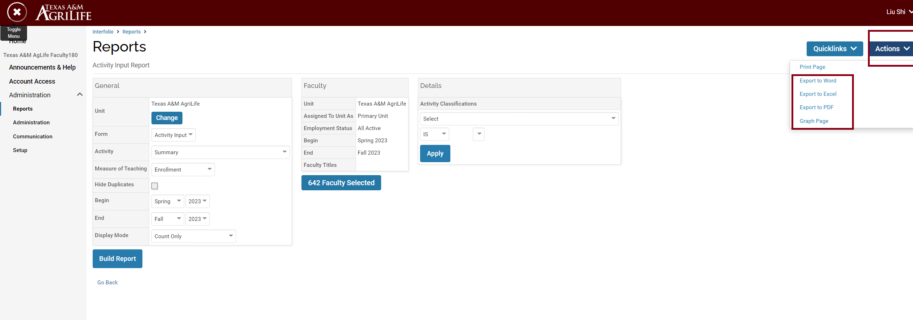
View and Export Aggregated Activity Data for Users in your Unit
The report can be exported by selecting “Export to …” from the “Actions” menu.

Slide 17
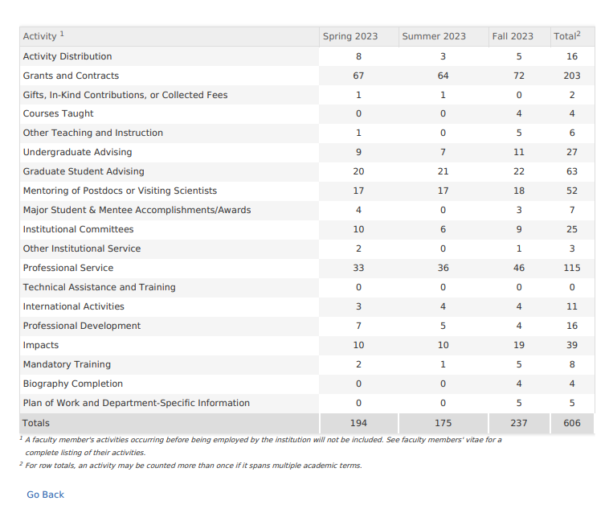
View and Export Aggregated Activity Data for Users in your Unit
The PDF versioned report looks like this:

