Slide 1
Using AgriLife Extension AG-478 Companion Report
Interfolio User Guide
For Extension Administrators
For questions about your experience in Faculty Activity Reporting, you can email the AgriLife help team at: agrilifef180help@ag.tamu.edu

Slide 2
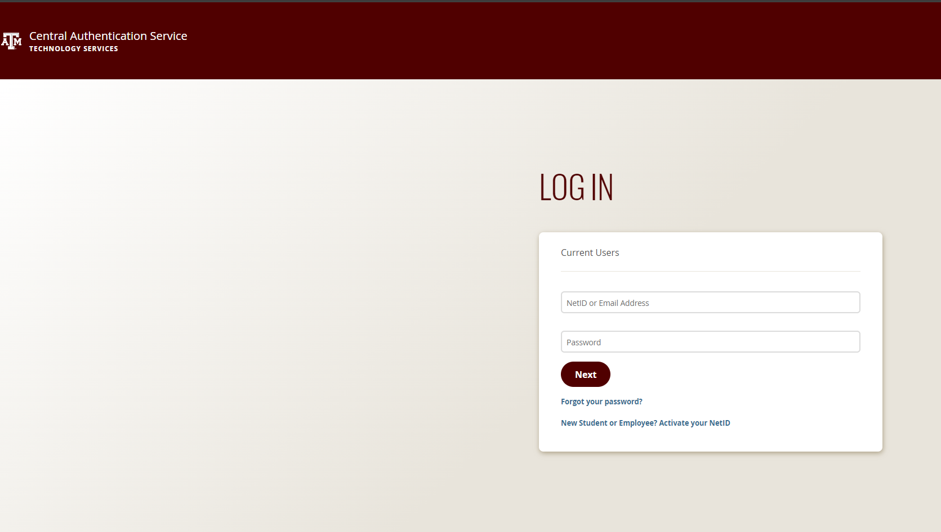
Log into Interfolio F180
To access the AgriLife version of Interfolio Faculty Activity Reporting (Faculty180), navigate to: tx.ag/agrilifeF180
This link will direct you to the TAMU CAC authentication page:

Slide 3
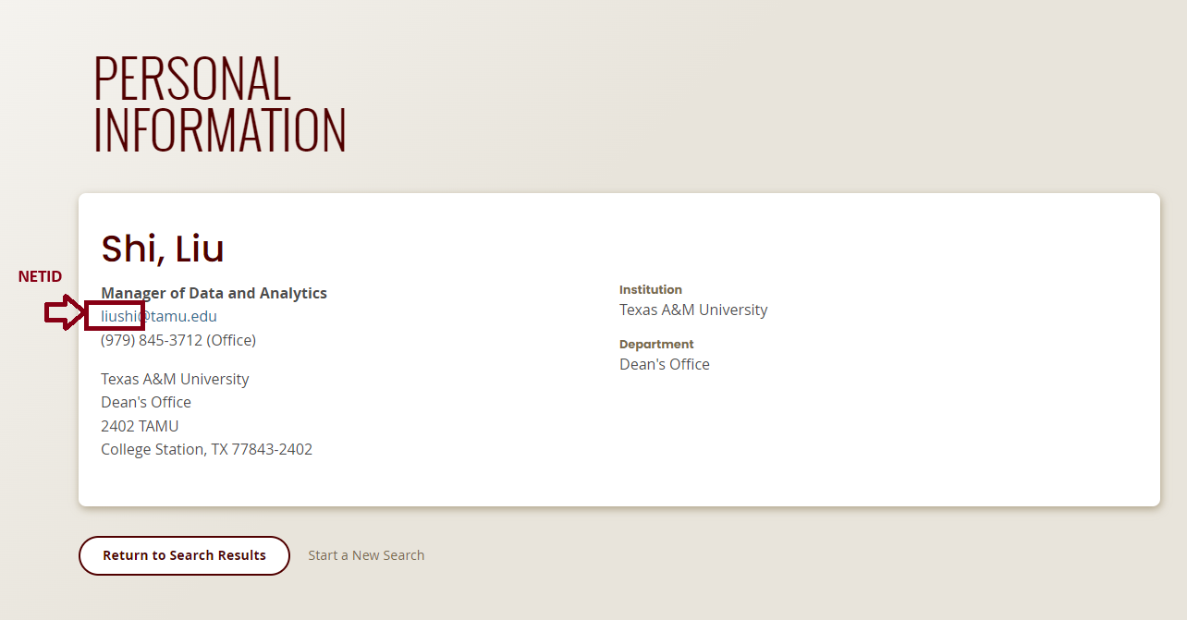
Log into Interfolio F180
To log in to this site, please use your TAMU NetID and its associated password.
Your TAMU NetID is typically linked to your TAMU email address.

Slide 4
Log into Interfolio F180
If you do not have a NetID, you will need to claim one first.
To do so, please visit https://gateway.tamu.edu/ and follow the instructions, using your UIN and date of birth to process your request.
Once you’ve claimed your NetID, please provide it to me so I can grant you access to AgriLife’s Interfolio F180.
Once access is granted, you can then use your NetID and its associated password to access Interfolio F180.
If you are a new administrator for your unit, please let us know so we can assign you full administrative rights to your unit.

Slide 5
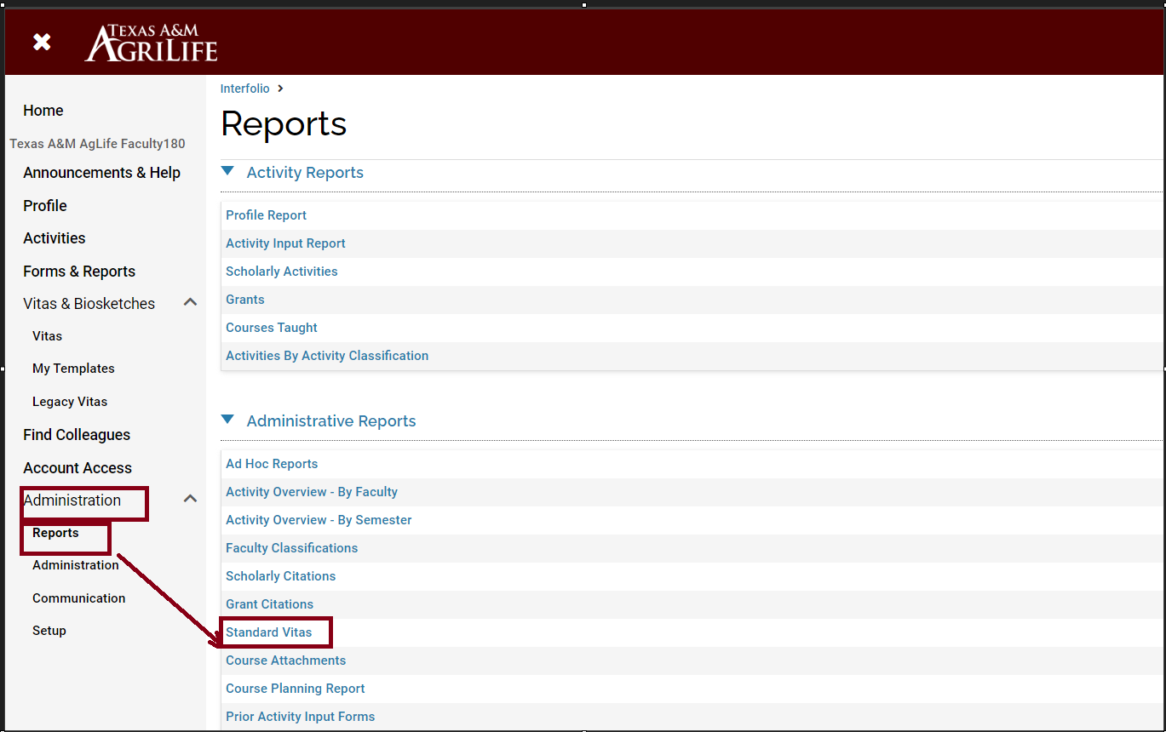
How to Find Faculty in Your Unit
Navigate to the “Administration” sub-menu and select “Standard Vita” under the “Reports” header.

Slide 6
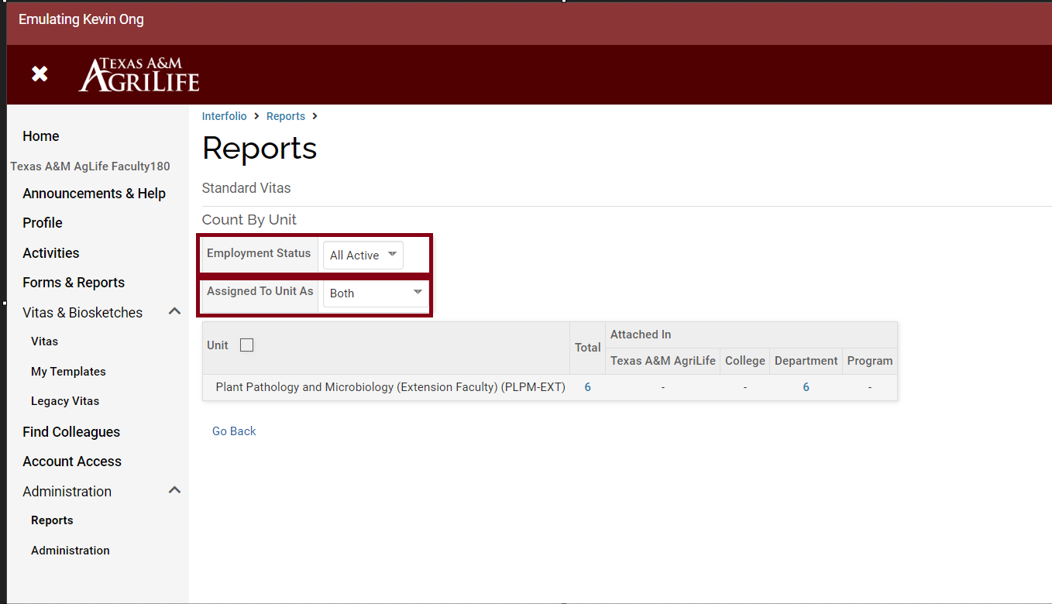
How to Find Faculty in Your Unit
We typically use “All Active” in the Employment Status filter, and “Both” in the Assigned to Unit As filter.

Slide 7
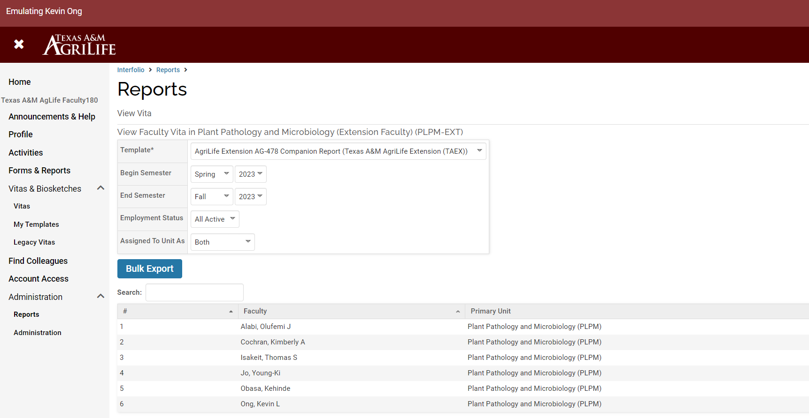
How to Find Faculty in Your Unit
Select the Total number to display all individuals under your unit. If you notice any faculty members missing in your unit, please notify us so we can add them accordingly.

Slide 8
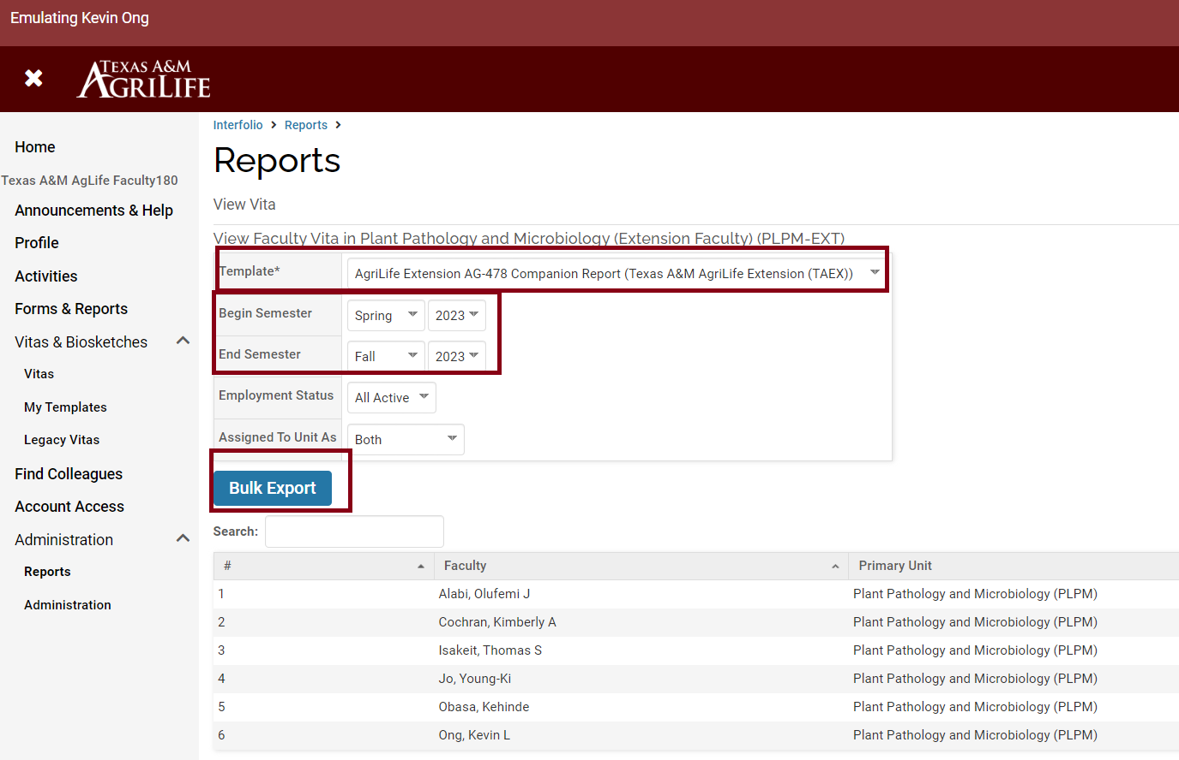
Create AG-478 Report for Your Unit
Select AG-478 report from the Template.
Then choose the semesters: for last year’s activities, select Spring 2023 to Fall 2023 for the report.
Click on Bulk Export.

Slide 9
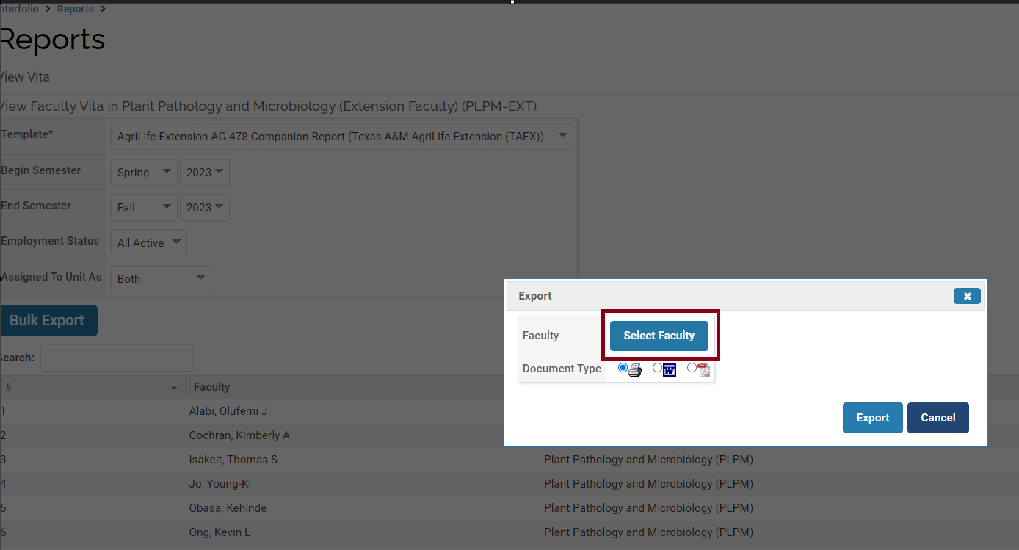
Create AG-478 Report for Your Unit
After selecting Bulk Export, a window will pop up. From there, choose “Select Faculty”

Slide 10
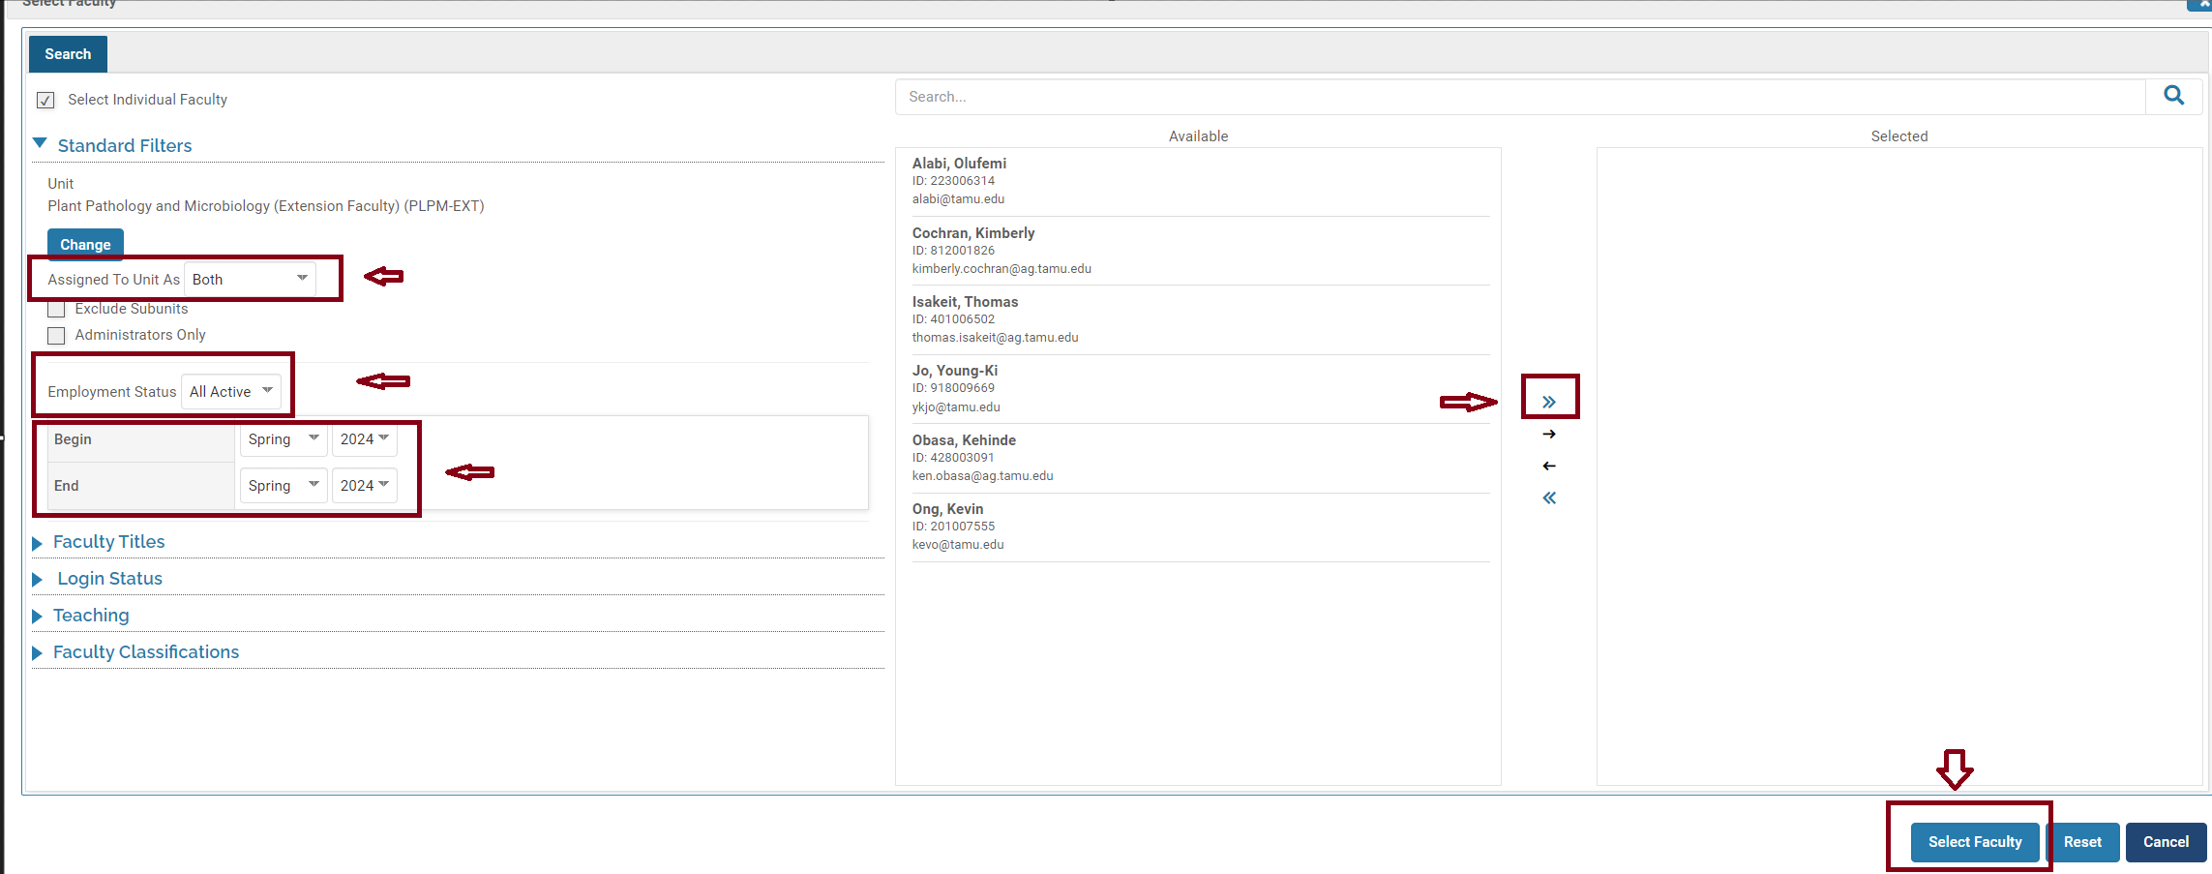
Create AG-478 Report for Your Unit
Another window will appear.
Select Assigned to Unit As “Both” and Employment Status to “All Active”
Then select the current period Spring 2024 to Spring 2024
Use the double arrow to move faculty over, then click on “Select Faculty”

Slide 11
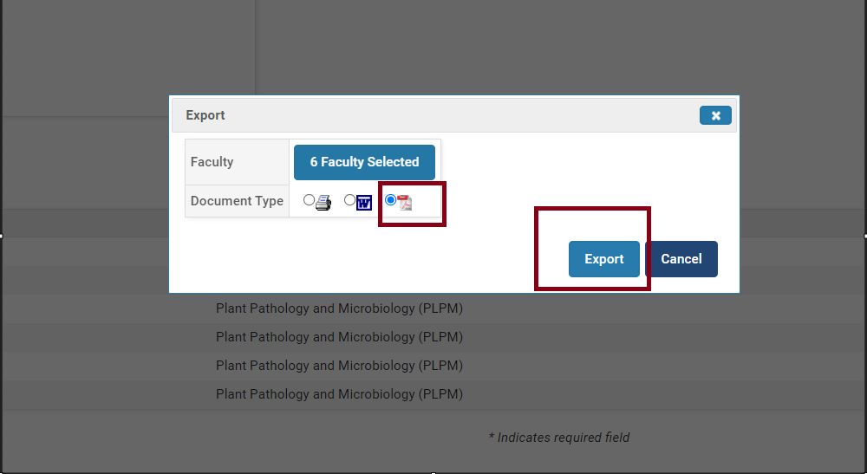
Create AG-478 Report for Your Unit
After making all of the previous selections, the window will show up, select PDF file, then Export

Slide 12
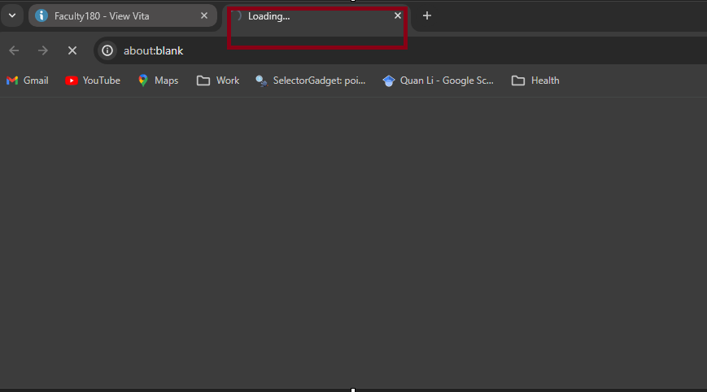
Create AG-478 Report for Your Unit
Another tab will open in Chrome, and the file will begin downloading.
Please note that if you have a large unit, it may take some time for the download to complete.

Slide 13
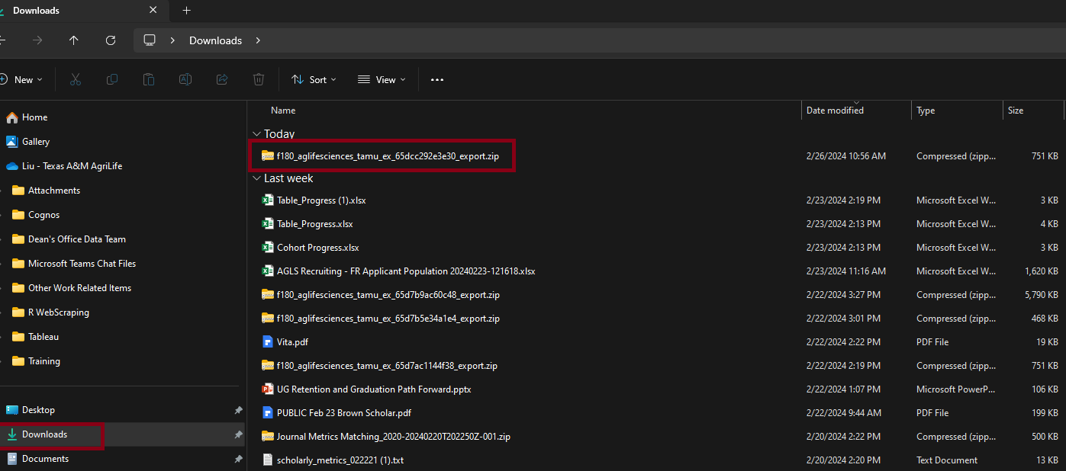
Create AG-478 Report for Your Unit
The file will be downloaded to your Downloads folder.
You'll find a zip folder present there.

Slide 14
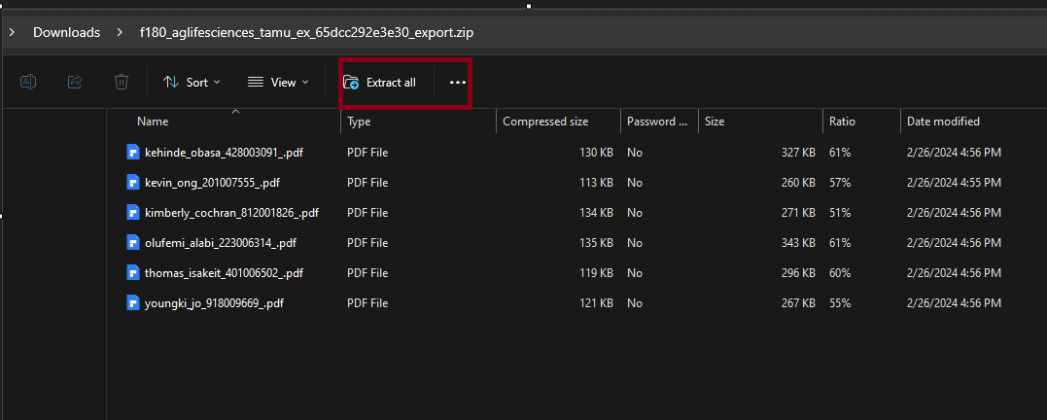
Create AG-478 Report for Your Unit
Open the zip file folder then choose Extract all.

Slide 15
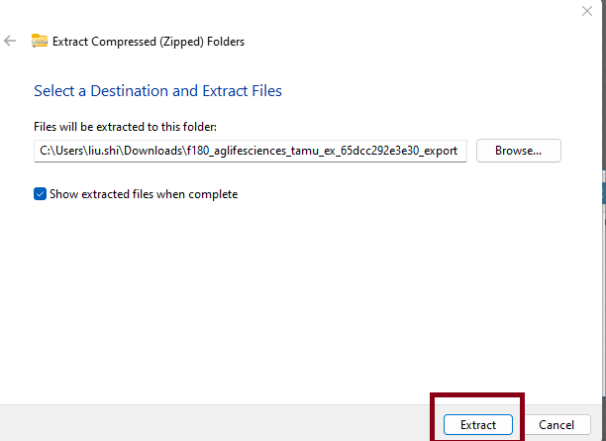
Create AG-478 Report for Your Unit
Leave the folder path as is, then click on “Extract”.

Slide 16
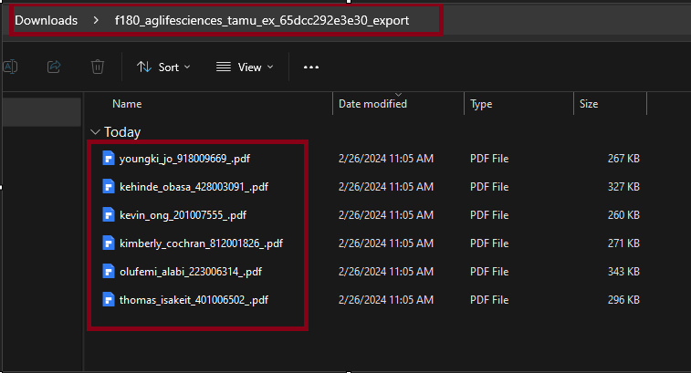
Create AG-478 Report for Your Unit
In the Downloads folder, you will find individual faculty AG-478 reports.
You can save the reports in your designated folder.

