Slide 1
Running AgriLife Faculty Activity Report
Texas A&M AgriLife Interfolio User Guide
For Administrators
For questions about your experience in Faculty Activity Reporting, you can email the AgriLife help team at: agrilifef180help@ag.tamu.edu

Slide 2
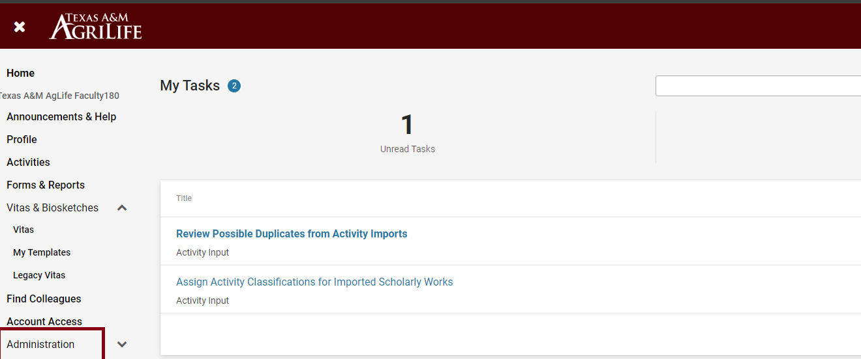
Bulk Exports Using AgriLife Faculty Activity Report
Navigate to the “Administration” tab on the left navigation menu.

Slide 3
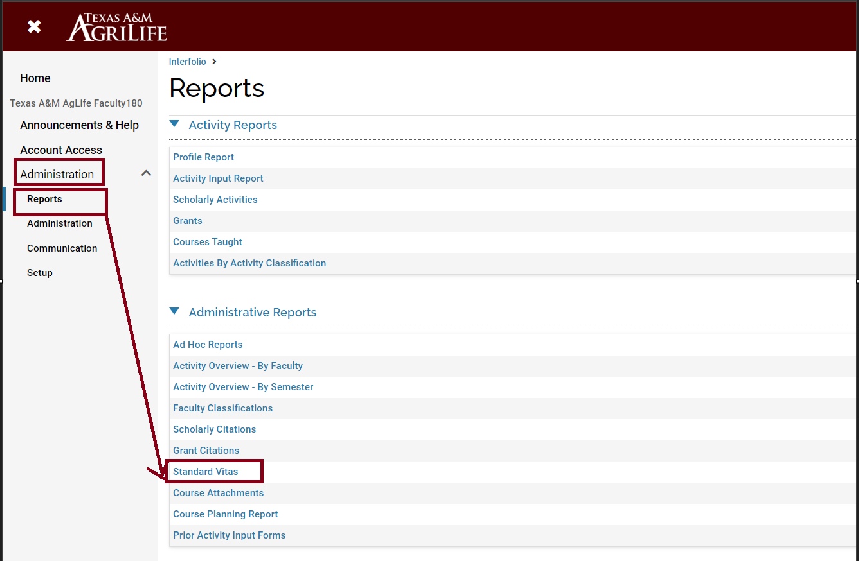
Bulk Exports Using AgriLife Faculty Activity Report
Navigate to the “Reports” sub-menu and select “Standard Vitas” under the “Administrative Reports” header.

Slide 4
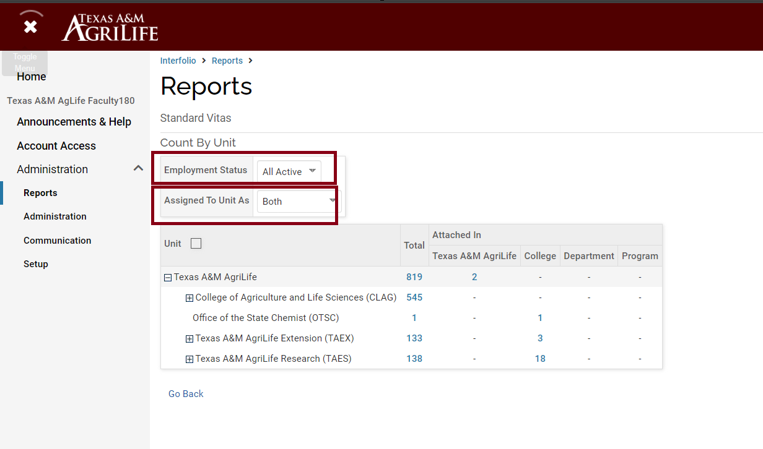
Bulk Exports Using AgriLife Faculty Activity Report
Adjust the ‘Employment Status’ and ‘Assigned To Unit As’ filters as appropriate. We recommend “All Active” and “Both”, respectively, to be as inclusive of employed faculty as possible.

Slide 5
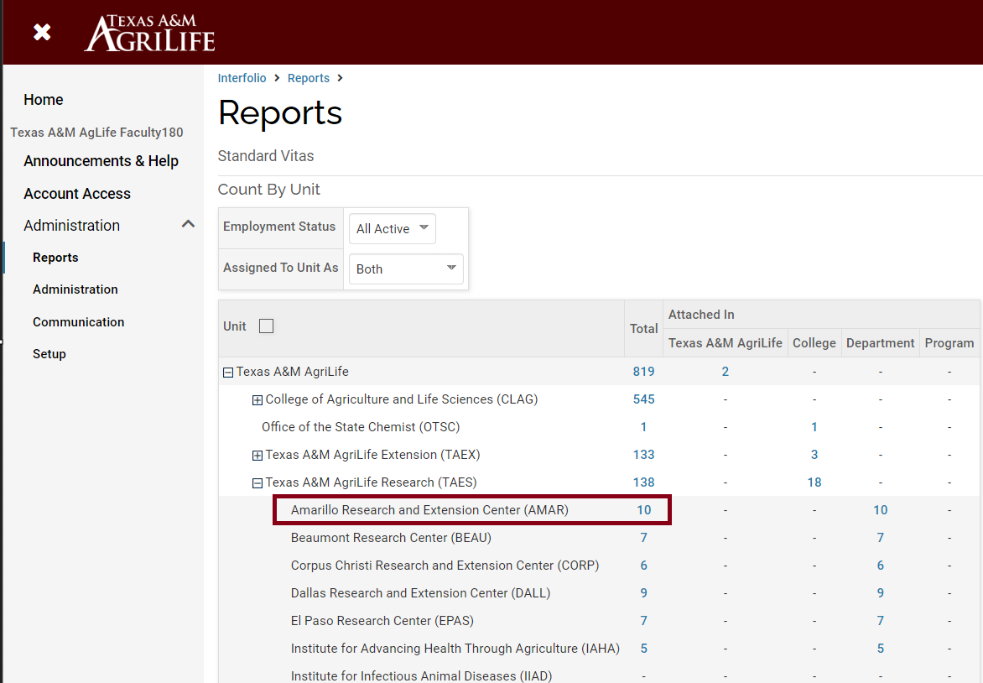
Bulk Exports Using AgriLife Faculty Activity Report
Click on the numeric headcount for the unit for which you’d like to see data. As an example, we could click on the 10 individuals tied to the Amarillo Research and Extension Center (AMAR) to expand data for those 10 faculty members.

Slide 6
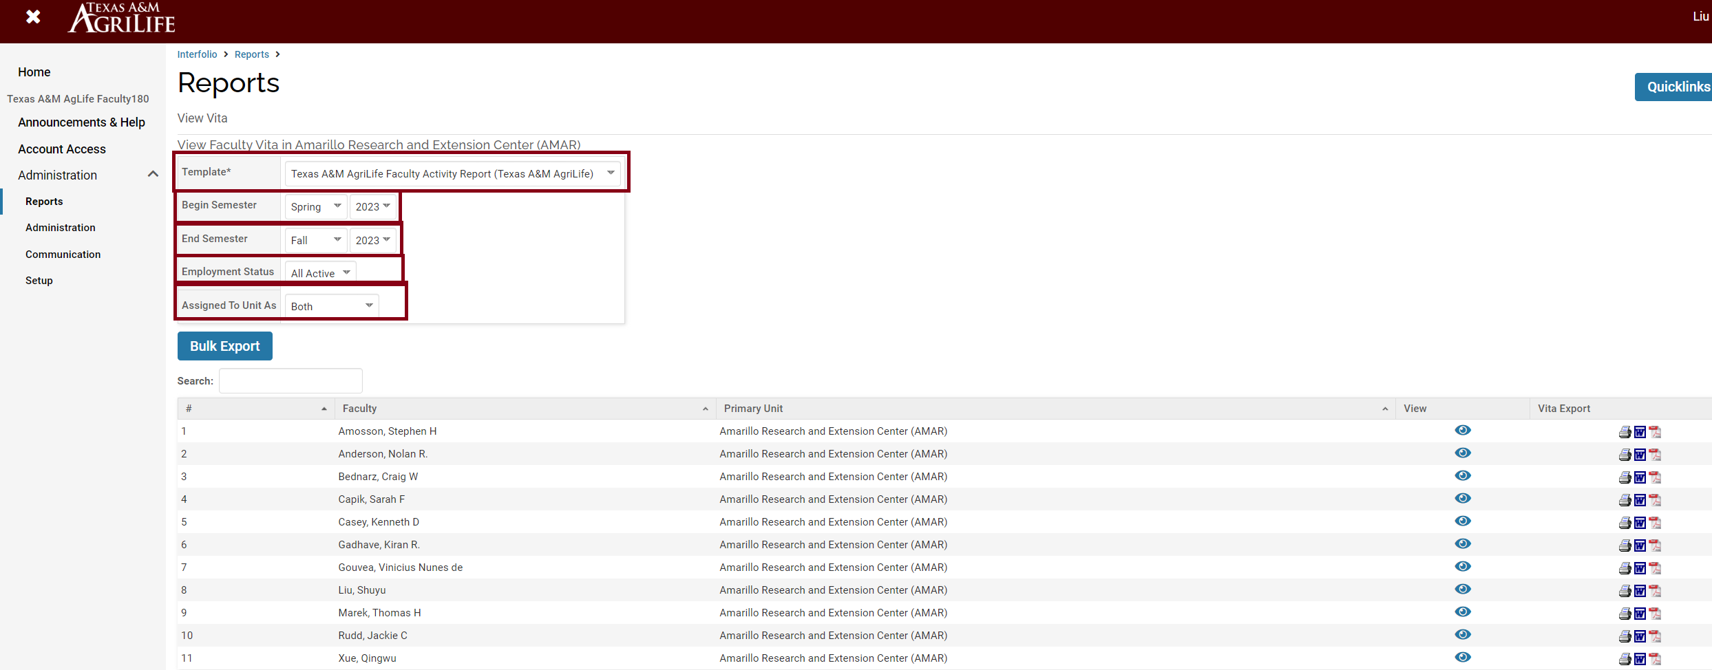
Bulk Exports Using AgriLife Faculty Activity Report
To access and view or export records in the correct format, choose the ‘Template’ format “Texas A&M AgriLife Faculty Activity Report”, and modify the date range for the appropriate year (e.g., Spring 2023 through Fall 2023 for the calendar year 2023), and then either choose to view individual records or the “Bulk Export” option.

Slide 7
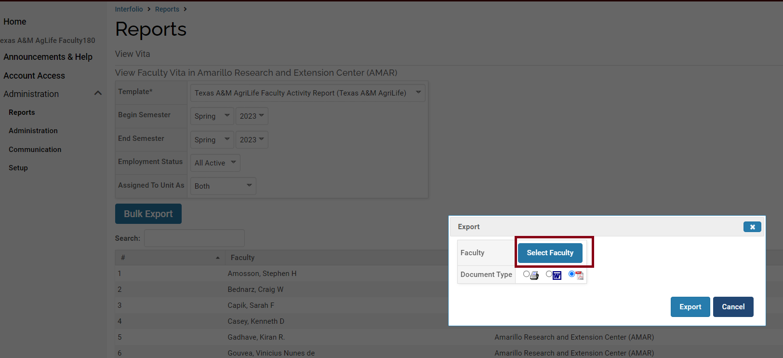
Bulk Exports Using AgriLife Faculty Activity Report
To export Activity Input reports in bulk, select the document type (i.e., the format you’d like Interfolio F180 to use for your file exports) and choose “Select Faculty.”.

Slide 8
Bulk Exports Using AgriLife Faculty Activity Report
To export Activity Input reports in bulk, select the document type in PDF and choose “Select Faculty.”.

Slide 9
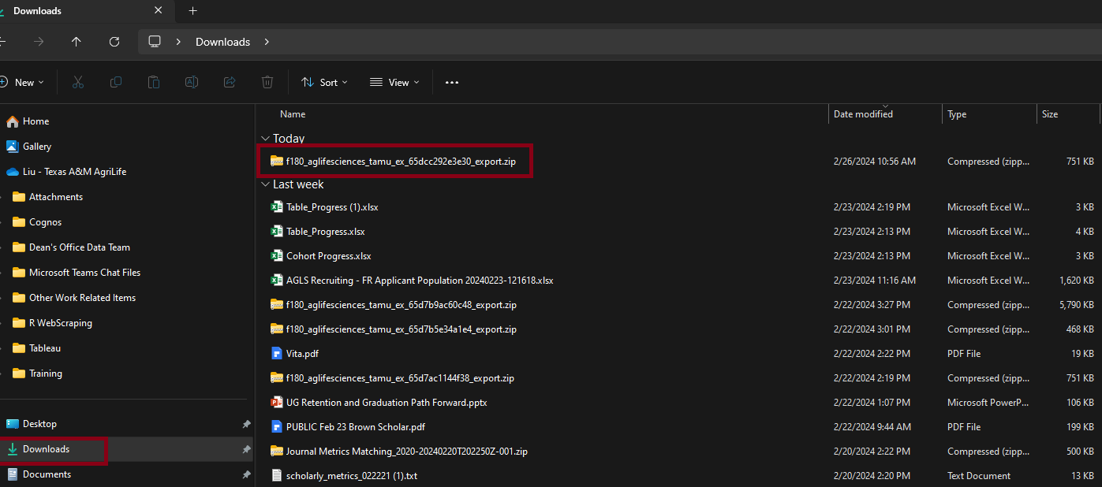
Bulk Exports Using AgriLife Faculty Activity Report
The file will be downloaded to your Downloads folder.
You'll find a zip folder present there.

Slide 10
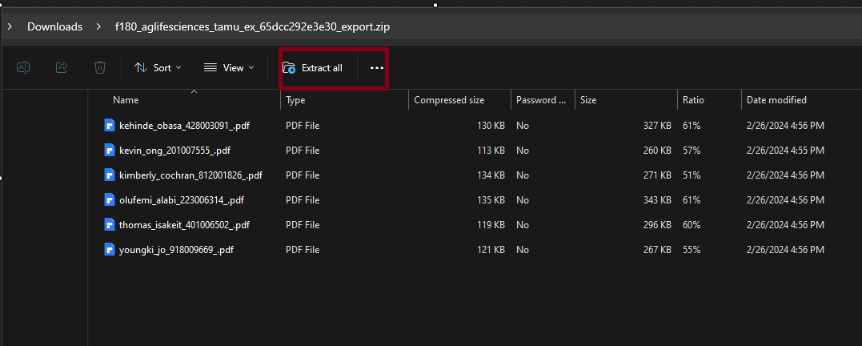
Bulk Exports Using AgriLife Faculty Activity Report
Open the zip file folder then choose Extract all.

Slide 11
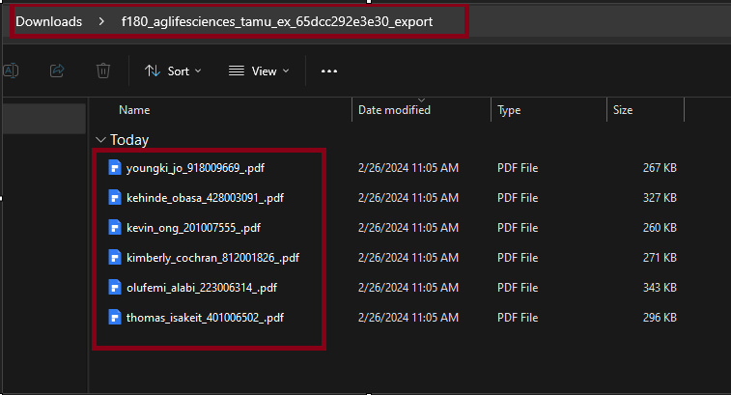
Bulk Exports Using AgriLife Faculty Activity Report
In the Downloads folder, you will find individual faculty AG-478 reports.
You can save the reports in your designated folder.

