Slide 1

Entering and Submitting Faculty Activities
Texas A&M AgriLife Interfolio User Guide
For Faculty Members
For questions about your experience in Faculty Activity Reporting, you can email the AgriLife help team at: agrilifef180help@ag.tamu.edu

Slide 2
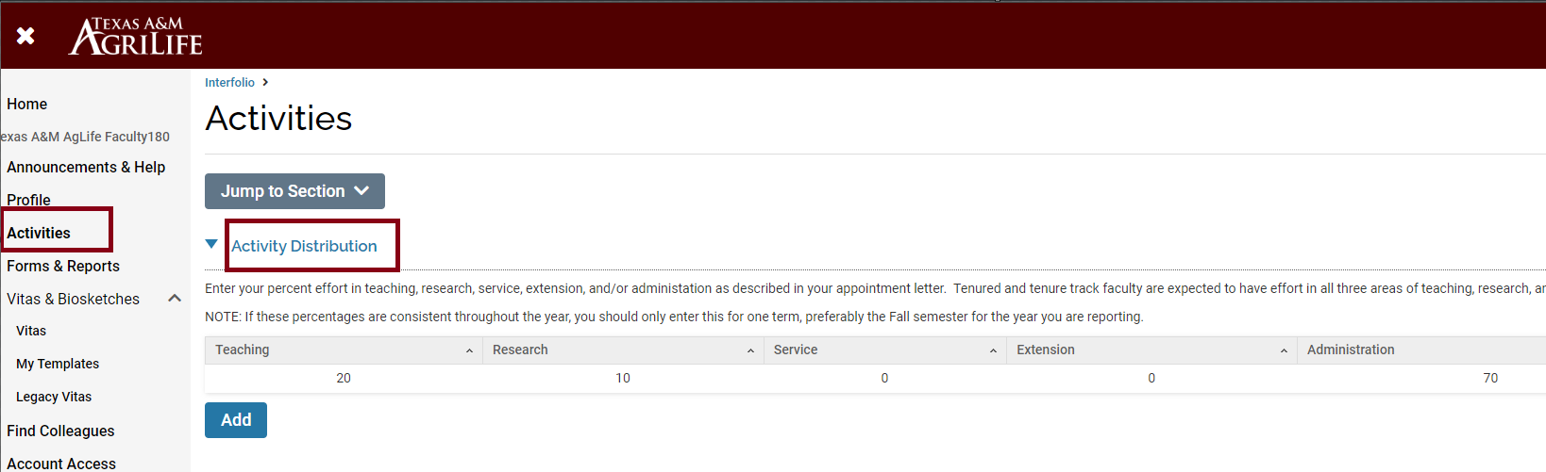
Activity Distribution
Go to the “Activities” Tab
Then go to the “Activity Distribution” Section, click “Add”.

Slide 3
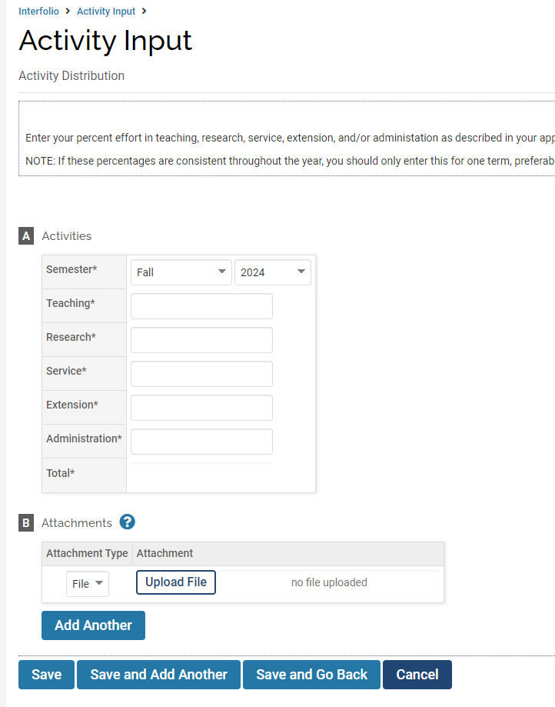
Activity Distribution

Slide 4
Activity Distribution
For those with multiple roles, estimate the annual percentage of time spent on teaching, research, extension, and administration. This distribution should reflect your role, not specific tasks. Refer to your reappointment letter for guidance.
Enter the term and year in Interfolio. If your activity distribution is consistent, you only need to enter data for the fall term. If it changes, enter data for each term.

Slide 5
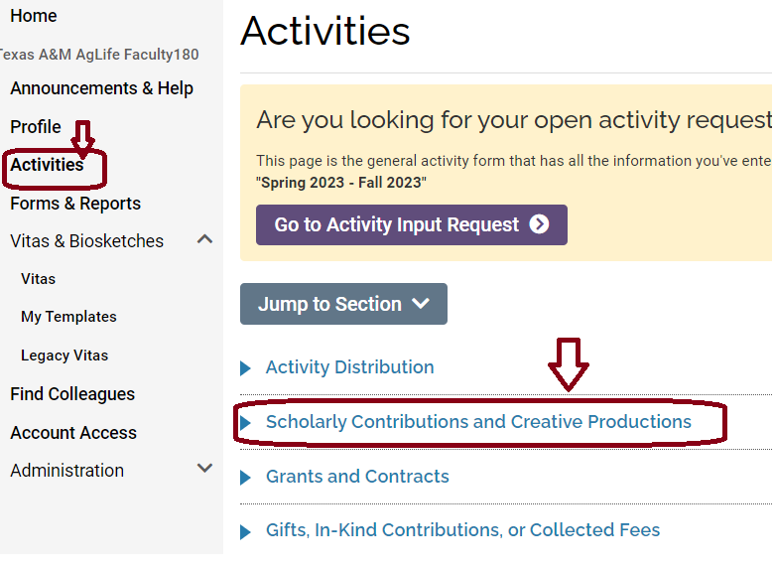
Scholarly Contributions and Creative Productions
Go to “Scholarly Contributions and Creative Productions” Section and click “Add”.

Slide 6
Scholarly Contributions and Creative Productions
This section includes a comprehensive list of activities. For Extension work, relevant activities like Curriculum Development, Testing, Program Development, and Evaluation are available.
You can enter these activities manually, or, if they are publicly available, import them using options like “Generic,” “Medline/PubMed,” or “Web of Science.”
Each option will be demonstrated next.

Slide 7
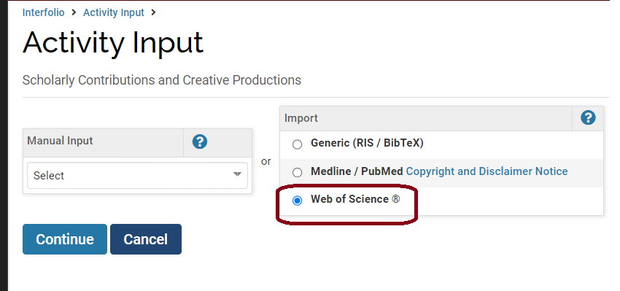
Scholarly Contributions and Creative Productions
- Web of Science Option
Choose Web of Science, then continue

Slide 8
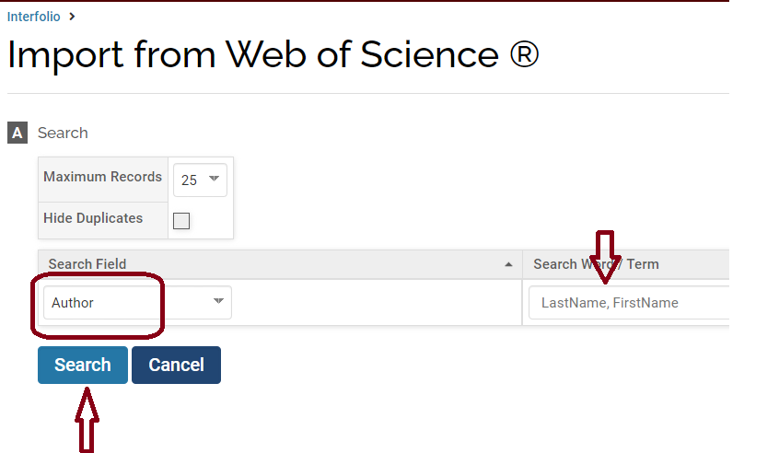
Scholarly Contributions and Creative Productions
- Web of Science Option
Select “Author”
Enter the Author’s name, then Search

Slide 9
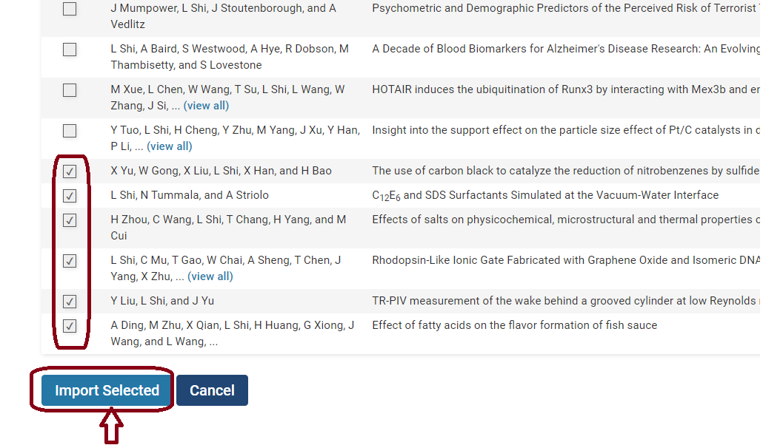
Scholarly Contributions and Creative Productions
- Web of Science Option
Select the correct publications
Click “Import Selected”

Slide 10
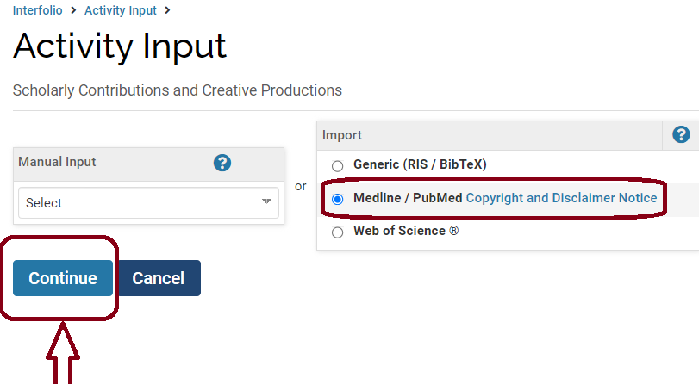
Scholarly Contributions and Creative Productions
- Medline/ PubMed Option
Another way to add is to choose “Medline/ PubMed”
Click “Continue”

Slide 11
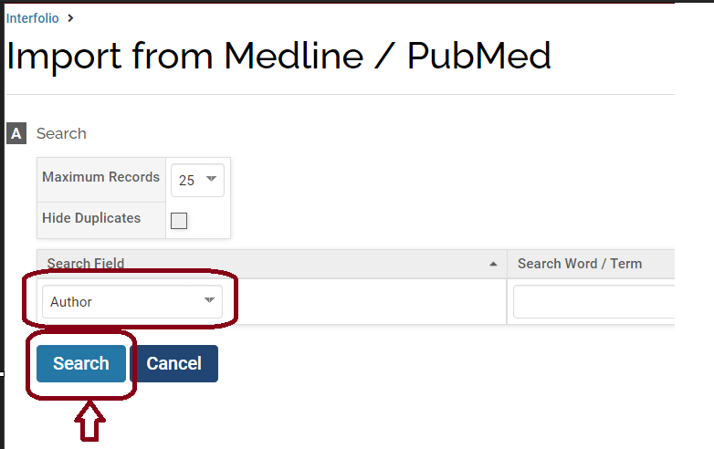
Scholarly Contributions and Creative Productions
- Medline/ PubMed Option
Search by the Author or any other criteria
Select the correct publications, then click “Import Selected”

Slide 12
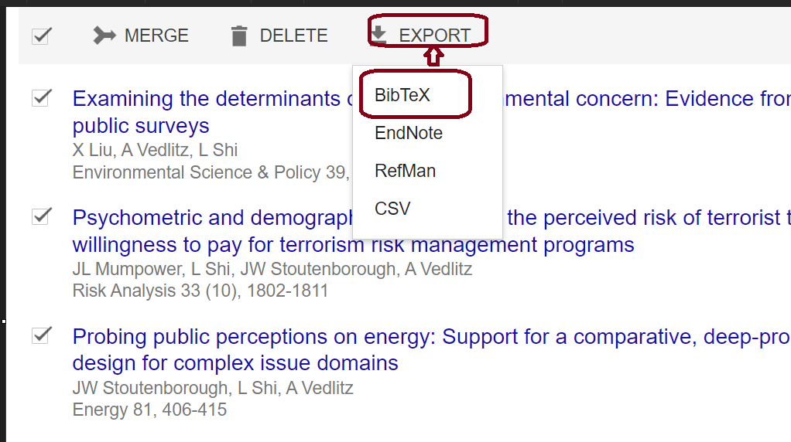
Scholarly Contributions and Creative Productions
- Generic (RIS/BibTeX) Option
A third option for adding activities is to select "Generic (RIS/BibTeX)“.
Click “Continue” and sign in to your Google Scholar account. Go to “My Profile” and select the publications you want to export.
Choose “BibTeX” and then click “EXPORT”.

Slide 13
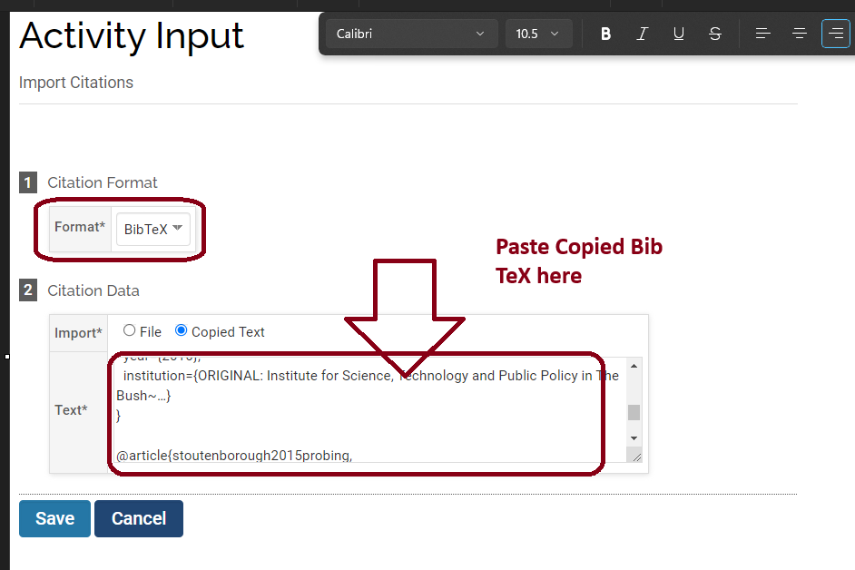
Scholarly Contributions and Creative Productions
- Generic (RIS/BibTeX) Option
A window will pop up. Select All, then copy the text.
Return to Interfolio F180, choose Format as BibTeX, paste the copied text in the “Text” box, and click “Save”.
s

Slide 14
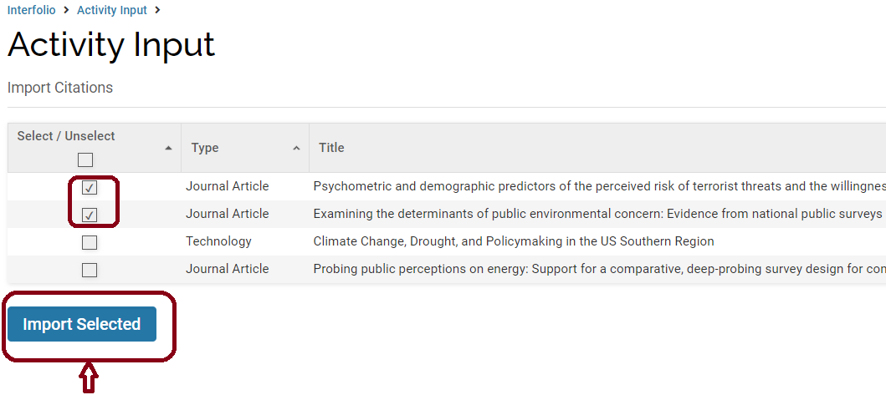
Scholarly Contributions and Creative Productions
- Generic (RIS/BibTeX) Option
Select the correct publications and Import Selected

Slide 15
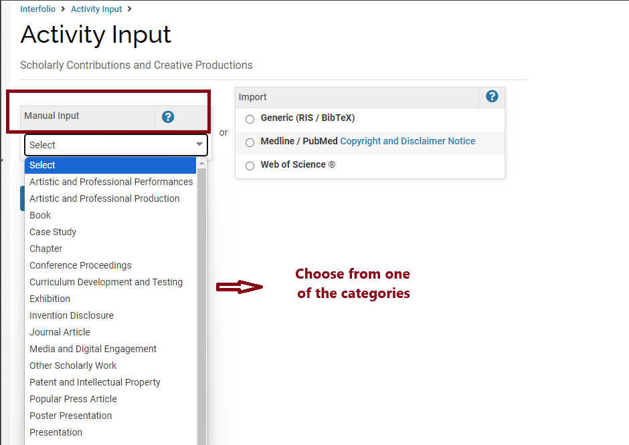
Scholarly Contributions and Creative Productions
- Manual Input Option
The last option is to use the “Manual Input” option.
Go to the “Manual Input”, choose from one of the categories, then “Continue”.

Slide 16
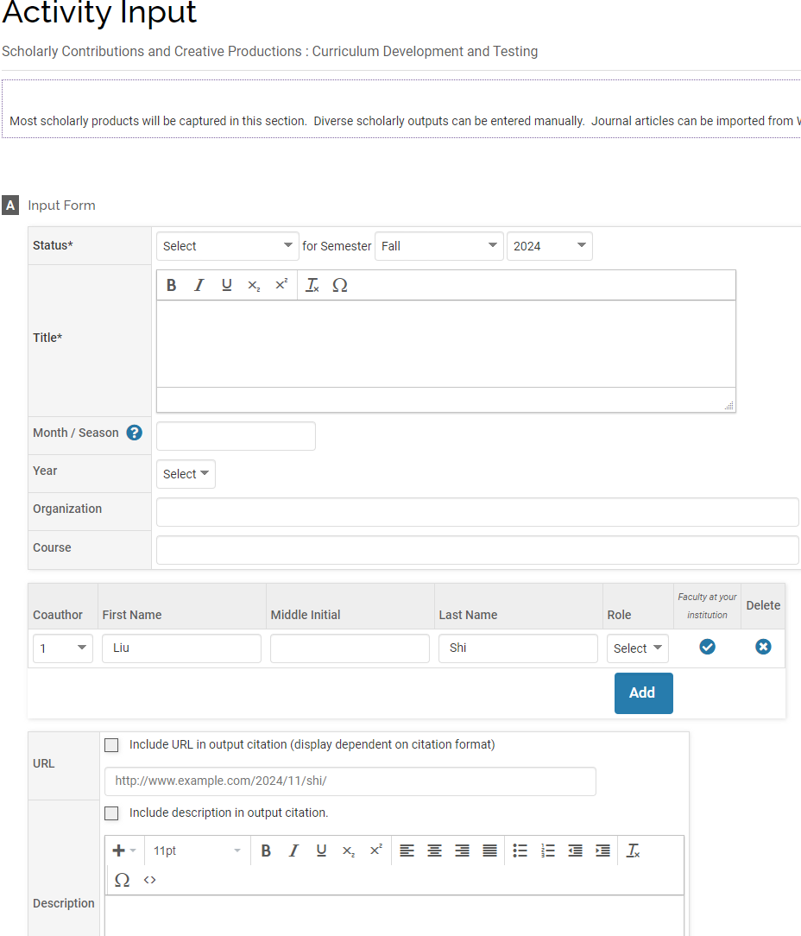
Scholarly Contributions and Creative Productions
- Manual Input Option
Fill out the detailed information as much as possible.

Slide 17
Things to Remind
Under each section, there is a detailed description to help you.
Check the “Status” field carefully.
Remove duplicate entries for the same journal articles with similar “Status”.
Confirm the “Term” in which each publication was published.
Avoid manual data entry whenever possible by using other import options.

Slide 18
Grants and Contracts
The data is sourced from Maestro and preloaded on behalf of faculty.
It is a snapshot of the proposal and award information.
Changes in Maestro data may take time to be reflected in Interfolio.
Some data cannot be edited.
Grants and contracts not included in Maestro can be manually entered into this section.

Slide 19
Other Sections
Courses Taught: Only courses taught at A&M will be preloaded on your behalf. If you teach at other institutions, you can enter the data in the “Other Teaching and Instruction” section.
AEFIS: A new section developed this year. Student course evaluation data from Helio/AEFIS is uploaded on your behalf.
Undergraduate Advising: Involves conducting projects with undergraduates and advising them.
Graduate Student Advising: Data is preloaded for you if you serve on the graduate committee. You can also manually add your advising service.

Slide 20
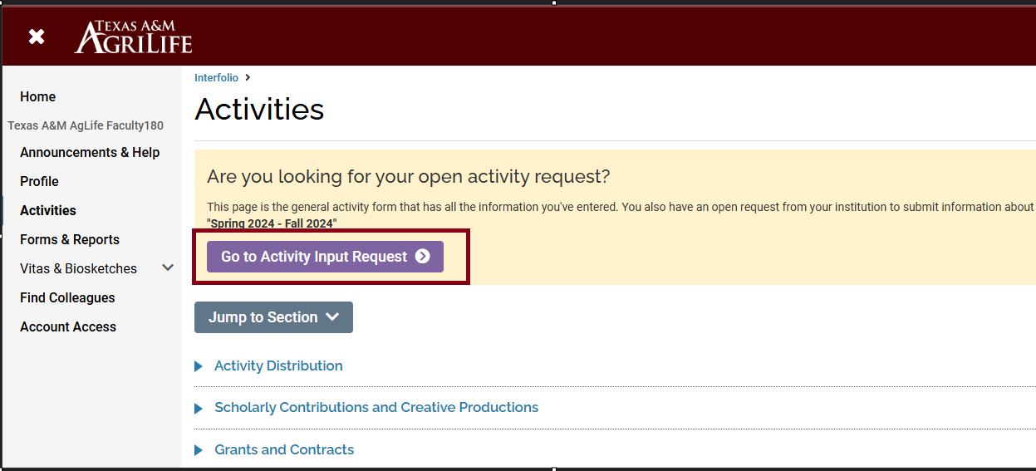
Review and Confirm Activities
Each year, the open activity input period runs from mid-November to mid-January. Faculty should update and confirm all information in F180 for administrator review.
After updating activities, scroll to the top of the Activities page and click the purple "Go to Activity Input Request" ribbon to verify your data.

Slide 21
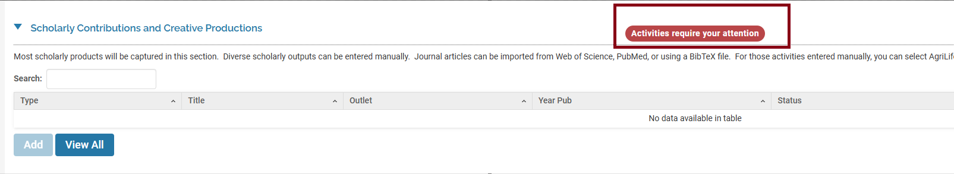
Review and Confirm Activities
Notice the red ribbon “Activities require your attention” on the upright side of sections that need attention, review the data, and “update”.

Slide 22
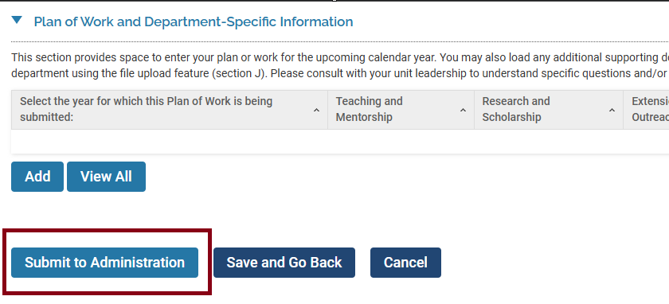
Submission
After confirming everything is correct and updating them, scroll to the bottom and hit “Submit to Administrator”.

